Slide 1

Amazon Sales in India
Unveiling Growth Patterns
N. SAI PRATHYUSHA
121322030019

Slide 2


Amazon Sales in India
INTRODUCTION
Amazon one of the leading e-commerce platforms in India. Amazon India offers a wide range of products, including clothing, electronics, books, and more. With a wide range of products and services, Amazon India has become a one-stop-shop for all your needs.
Clothing Sales Overview
Clothing is one of the top-selling categories on Amazon India. From traditional Indian clothing to Western wear, Amazon India offers a diverse selection of clothing for all occasions and age groups.
The convenience of online shopping and the availability of a wide range of options have made Amazon India a popular destination for clothing shopping in India.
Let’s see the analysis

Slide 3
PROBLEM STATEMENT
Amazon Sales in India
In the fast-evolving landscape of e-commerce, understanding the dynamics of Amazon’s sales performance in the Indian market has become a critical challenge. As Amazon continues to expand its presence in India, there is a pressing need to comprehensively analyze its sales data to uncover insights that can inform strategic decision-making.
TOOL USED
Tableau Desktop is the primary tool used to create and design the interactive dashboards and visualizations. It provides a user-friendly interface for connecting to data sources, building data visualizations, and creating interactive dashboards.

Slide 4
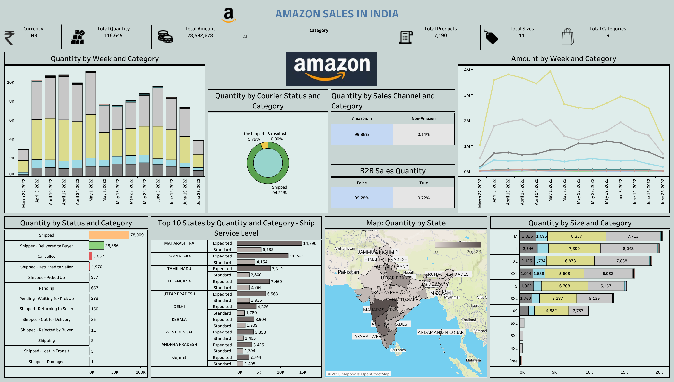
DASHBOARD

Slide 5
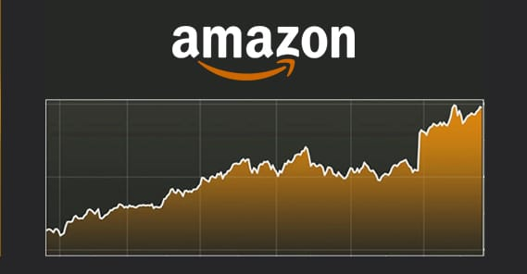
CONCLUSION
Amazon Sales in India
This comprehensive analysis has provided a deeper understanding of various aspects of Amazon's performance, customer behaviour, regional dynamics, pricing strategies, and courier efficiency.
Here are the key conclusions drawn from this project:
Sales Performance and Growth
Customer Behaviour
Pricing Strategies
Regional Dynamics
Courier and Delivery Efficiency
Top 10 States by Quantity and Category-Ship Service Level

Slide 6
Amazon Sales in India
THANK YOU

